Slide 1











DATA SCIENCE

Slide 2
#1 BASICS OF CODING PYTHON
1.Using Comments Python :
In Python, comments are used to add explanatory notes or annotations within the code. Comments are ignored by the Python interpreter and are meant for human readers to understand the code better. Python supports two types of comments: single-line comments and multi-line comments.

Slide 3
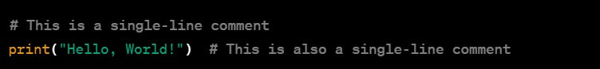
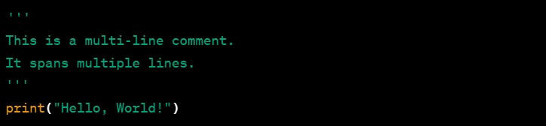
Single Line Comments :
SINGLE-LINE COMMENTS START WITH THE # SYMBOL AND CONTINUE UNTIL THE END OF THE LINE.
Multi-Line Comments :
YOU CAN USE TRIPLE-QUOTES (''' OR """) TO CREATE A MULTI-LINE STRING

Slide 4
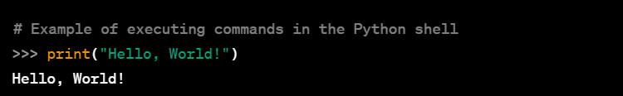
2. Executing command of python
Python is an interpreted language, meaning you can execute code line by line or run entire scripts. You can use an interactive Python shell or create Python scripts with the .py extension.
Interactive Python Shell (Command Line):
Open your terminal or command prompt.
Type python or python3 to enter the Python shell.

Slide 5
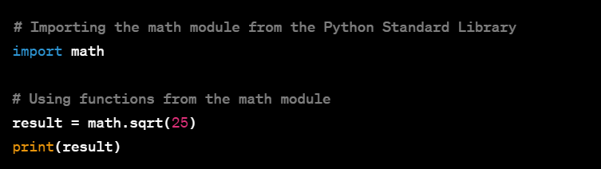
3.IMPORTING PACKAGES
In Python, you can import a package using the import keyword. A package is a way of organizing related modules into a single directory hierarchy. Here's how you can import a package in Python:
I). Importing a Specific Module from a Package:

Slide 6
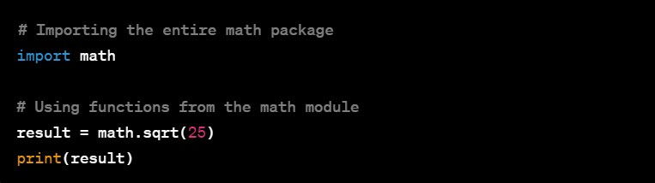
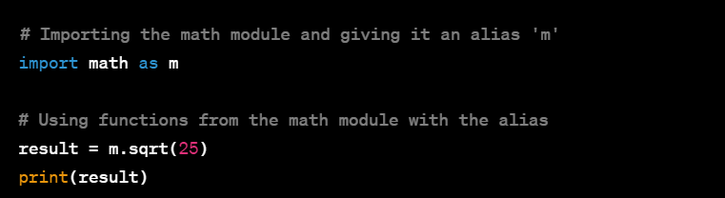
II). Importing the whole Package
III). Importing as Alias

Slide 7
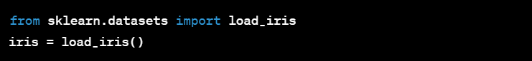
4. Getting Data into Python
To perform data science in Python, you need to acquire and manipulate data. There are several ways to obtain data for your data science projects. Here are some common methods:
I).Use Existing Datasets:

Slide 8
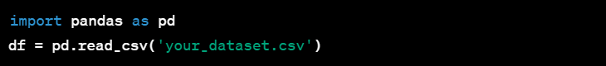
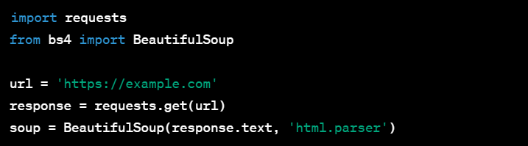
II). Access Public Datasets:
III). Web Scrapping :

Slide 9
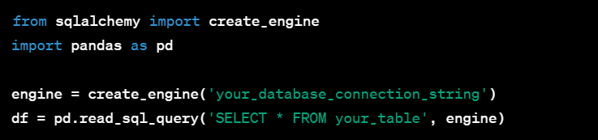
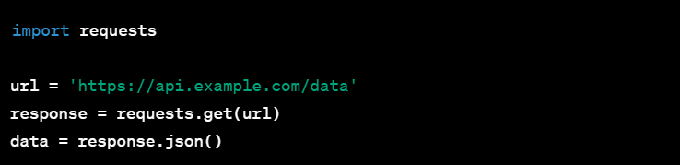
IV). Database Access :
V). APIs :

Slide 10
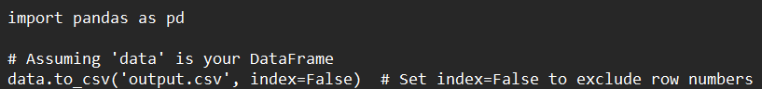
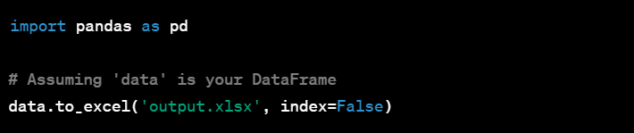
5. Saving output Python
I).Saving to a Text File
II). Saving to an Excel file

Slide 11
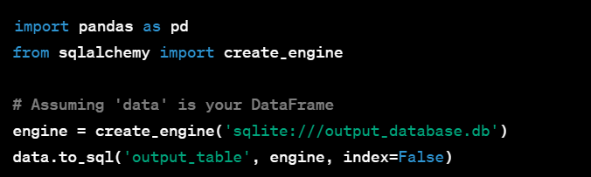
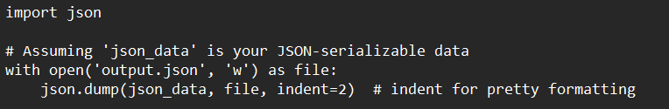
III). Saving to a Database
IV). Saving to a JSON File

Slide 12
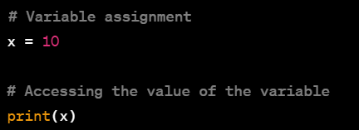
6. Accessing Records and Variables Python
I). Accessing Variables in Python:
Single Variable:

Slide 13
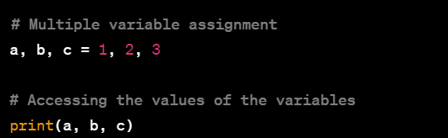
Multiple Variables

Slide 14
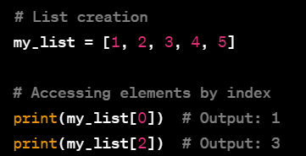
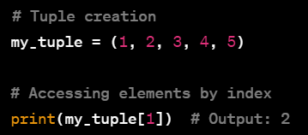
II). Accessing Records in Python:
Lists:
Tuples:

Slide 15
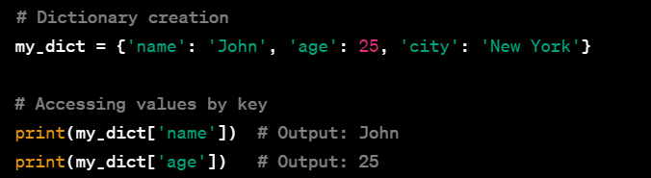
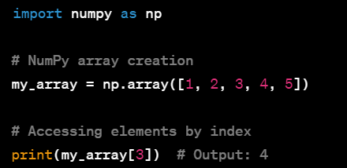
Dictionaries:
NumPy Arrays:

Slide 16
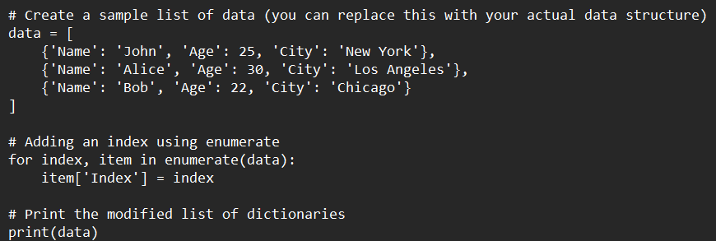
#2. DATA PREPARATION
1). How to add an Index field using Python:
In Python, if you want to add an index field to your data, you can do this using the enumerate function or by using the built-in range function. Below are examples using both approaches:
Using enumerate:

Slide 17
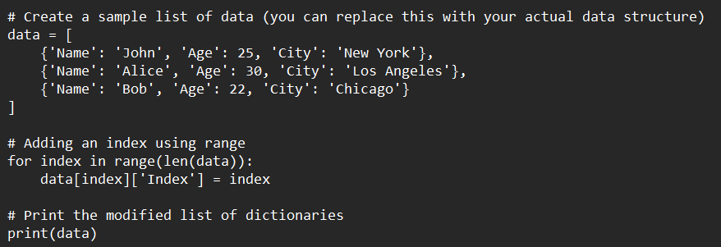
Using range:

Slide 18
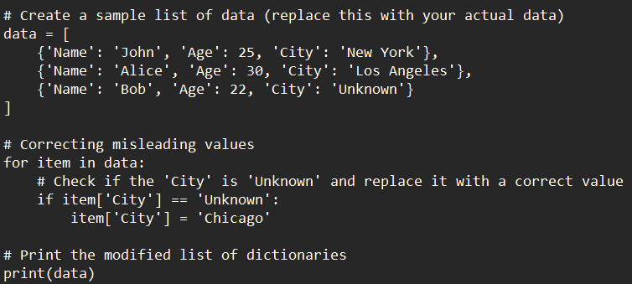
2. How to Change Misleading Field Values Using Python:
To change misleading or incorrect field values in Python, you can use conditional statements and update the values accordingly. Here are examples using both lists of dictionaries and Pandas DataFrames:
Using Lists of Dictionaries:

Slide 19
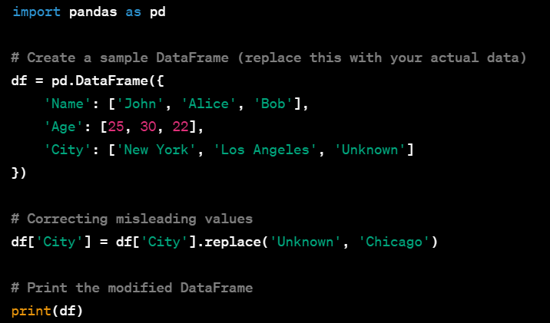
Using Pandas DataFrame:

Slide 20
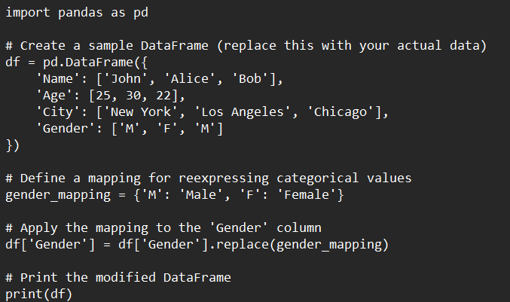
3). How to Re-express Categorical Field Values Using Python
To reexpress or transform categorical field values in Python, you can use the replace method for Pandas Data Frames or a custom mapping for lists of dictionaries. Here are examples using both approaches:
Using Pandas DataFrame:

Slide 21
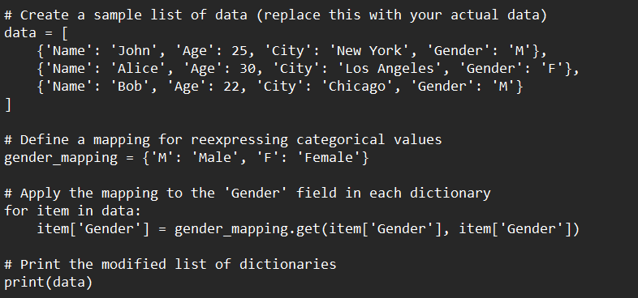
Using Lists of Dictionaries:

Slide 22
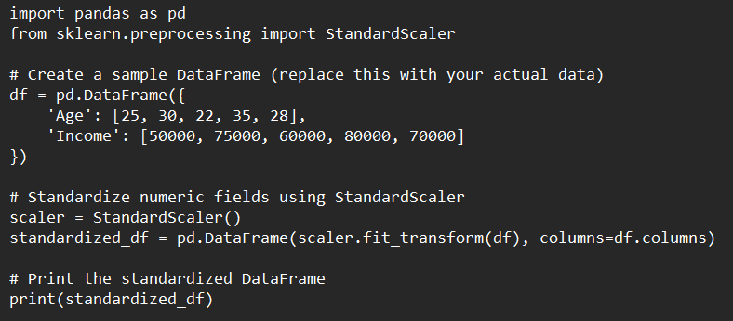
4. How to Standardise Numeric Fields Using R/Python
To standardize numeric fields in Python, you can use the StandardScaler class from the sklearn.preprocessing module. Here's an example using a Pandas DataFrame:

Slide 23
5. How to Identify Outliers Using R/Python:
Identifying outliers is an important step in data analysis to ensure that extreme values do not unduly influence the results. There are various methods to identify outliers in Python, and I'll show you a couple of common approaches using a Pandas Data Frame and the seaborn library for visualization.

Slide 24
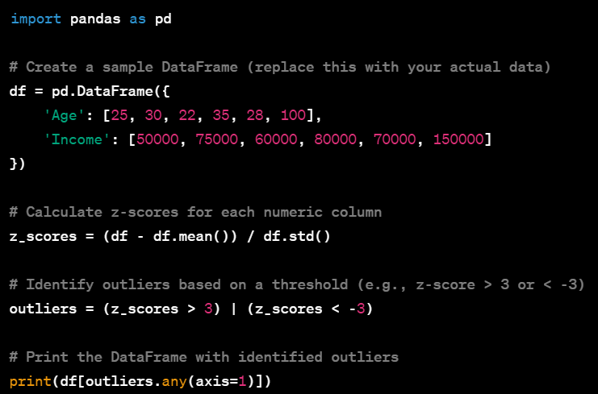
Using Descriptive Statistics:
One common method for identifying outliers is to look at descriptive statistics like mean, standard deviation, and quartiles.
In this example, z-scores are calculated, and any data point with an absolute z-score greater than 3 is considered an outlier.

Slide 25
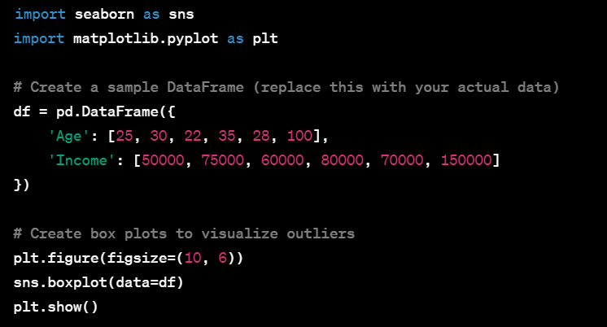
Using Visualization:
Visualizing the data using box plots or scatter plots can also help identify outliers.
Box plots can visually highlight potential outliers beyond the whiskers.

Slide 26
#3. EXPLORATORY DATA ANALYSIS
1). How to Construct a Bar Graph with Overlay Using Python
To construct a bar graph with overlays in Python, we can use the matplotlib library. a basic example of a bar graph with overlays using random data.

Slide 27
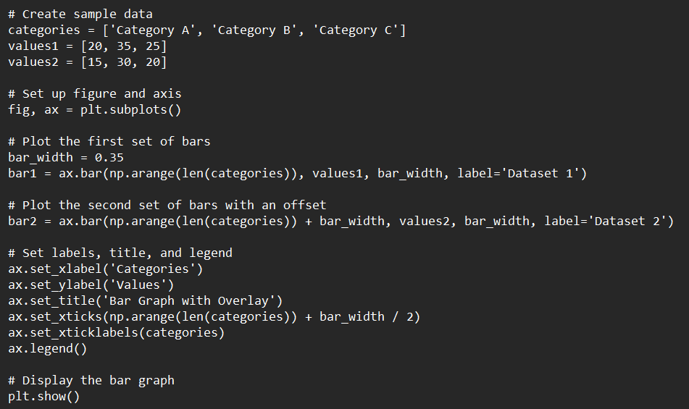
In this example:
categories represents the labels on the x-axis (e.g., categories or groups).
values1 and values2 represent the corresponding values for two datasets.
Two sets of bars (bar1 and

Slide 28
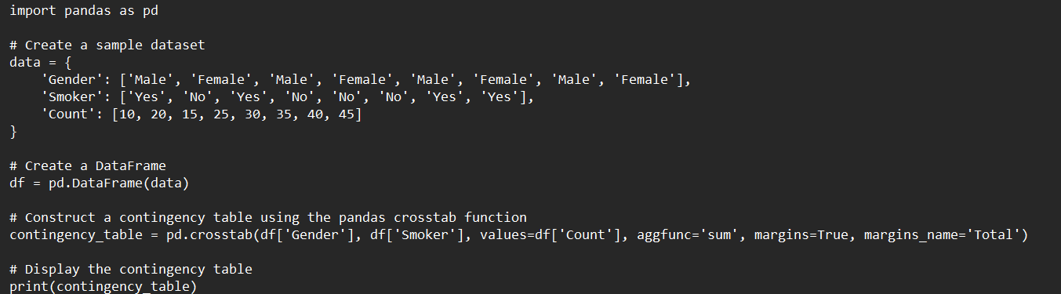
2). How to Construct Contingency Tables Using R/Python
To construct contingency tables in Python, we can use the pandas library, which provides a convenient way to create and manipulate data tables. Contingency tables are commonly used in statistics to represent the relationships between categorical variables. Here's a simple example:

Slide 29
In this example:
Gender and Smoker are categorical variables.
Count represents the frequency or count for each combination of gender and smoking status.
The pd.crosstab function is used to create the contingency table. Here are the parameters used:
df['Gender'] and df['Smoker']: The categorical variables for the rows and columns.
values=df['Count']: The values to be aggregated in the table.
aggfunc='sum': The aggregation function (you can use other functions like 'count', 'mean', etc.).
margins=True: Adds row and column totals.
margins_name='Total': Sets the name for the totals.

Slide 30
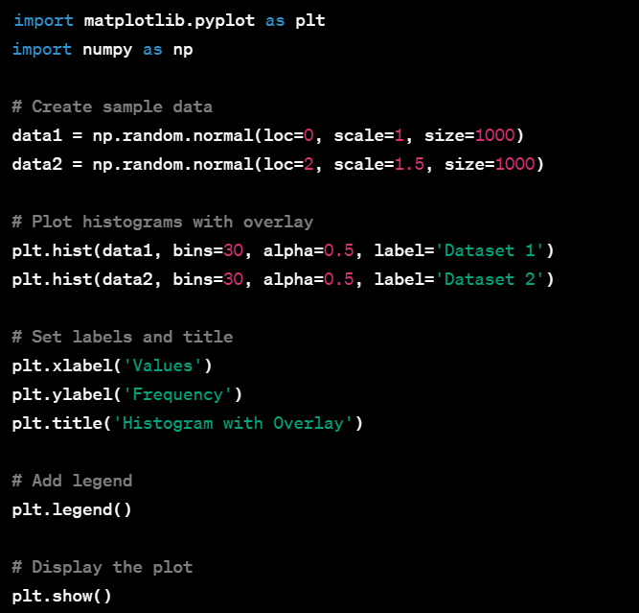
3). How to Construct Histograms with Overlay Using Python
To construct histograms with overlays in Python, we can use the matplotlib library. Here's an example that shows how to create a histogram with multiple datasets overlaid:

Slide 31
In this example:
data1 and data2 are two sets of random data.
plt.hist is used to create histograms for each dataset.
alpha=0.5 controls the transparency of the histograms, making it easier to see overlaps.
label is used to label each dataset.
plt.legend() adds a legend to the plot.

Slide 32
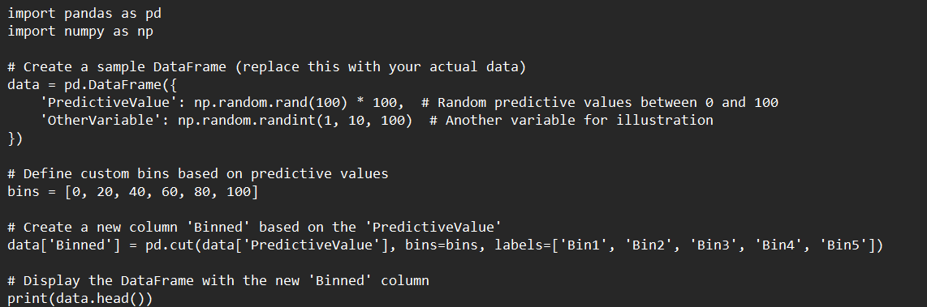
4). How to Perform Binning Based on Predictive Value Using R/Python
Binning is a process of grouping continuous data into discrete intervals or bins. If you want to perform binning based on predictive values, you can use the cut function in Pandas to define custom bins based on specific criteria. Here's an example:

Slide 33
In this example:
PredictiveValue is a continuous variable that you want to bin.
bins is a list defining the bin edges.
labels is a list providing labels for each bin.
The cut function is used to bin the 'PredictiveValue' based on the specified bins.

Slide 34
#4: DATA PREPARATION PHASE TO MODEL THE DATA
1). How to Partition the Data R/Python
Partitioning data in Python typically refers to splitting a dataset into multiple subsets or groups. This can be useful for tasks such as model training and testing, data preprocessing, or creating validation sets. Here are a few ways to partition data in Python:

Slide 35
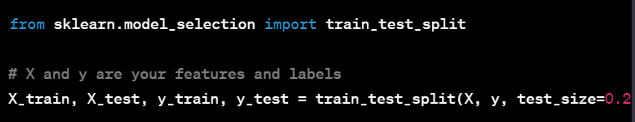
I). Using scikit-learn:
Scikit-learn provides a convenient train_test_split function for splitting data into training and testing sets.
Adjust the test_size parameter to control the proportion of data allocated for testing.

Slide 36
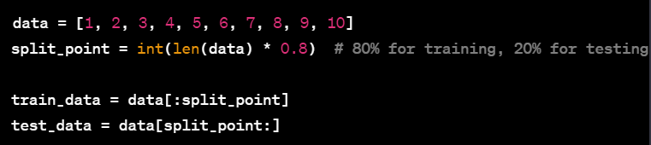
II). Manual Partitioning:
You can manually partition your data using array slicing or other methods.
This is a simple example for a list; you can adapt it for your specific data structure.

Slide 37
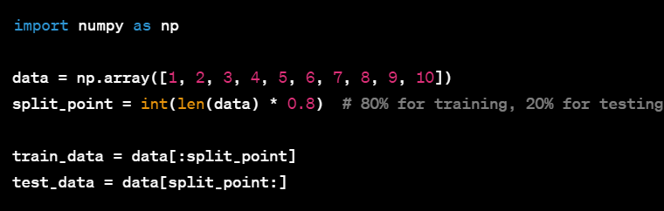
III). Using NumPy:
If your data is in NumPy arrays, you can use the same slicing approach.

Slide 38
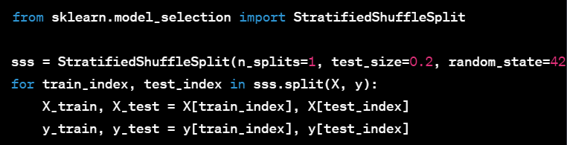
IV). Stratified Sampling:
If you have labeled data and want to ensure that the distribution of labels is maintained in both training and testing sets, you can use StratifiedShuffleSplit from scikit-learn.

Slide 39
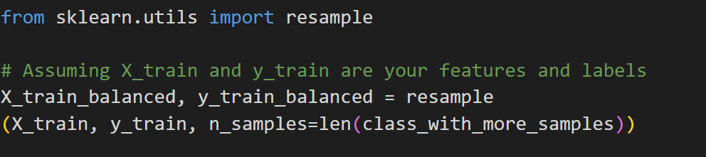
2.)How to Balance the Training Data Set Python :
Balancing a training dataset is a common step in machine learning, especially when dealing with imbalanced classes. Imbalanced classes occur when one class has significantly fewer samples than another, and this can lead to biased model training. Here are some techniques to balance a training dataset in Python:
I). Random Undersampling :
Randomly remove samples from the over-represented class to make the class distribution more balanced.

Slide 40
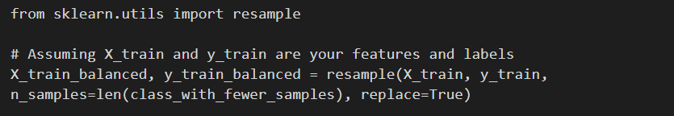
II). Random Oversampling:
Randomly duplicate samples from the under-represented class to balance the class distribution.

Slide 41
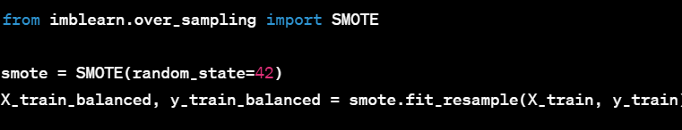
III). SMOTE (Synthetic Minority Over-sampling Technique):
Generate synthetic samples for the minority class to balance the dataset.
Make sure to install the imbalanced-learn library (pip install imbalanced-learn) if you haven't already.

Slide 42
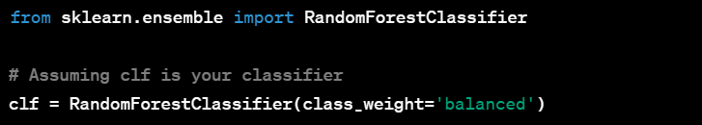
IV). Class Weights:
Some machine learning algorithms, especially in scikit-learn, allow you to assign different weights to classes. This way, the algorithm gives more importance to the minority class during training.

Slide 43
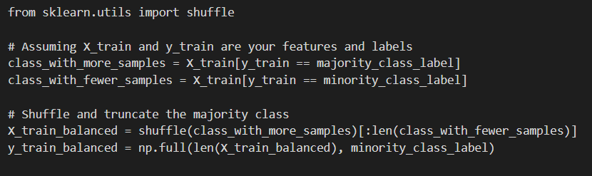
V). Custom Sampling:
Create a custom sampling strategy based on your specific requirements.

Slide 44
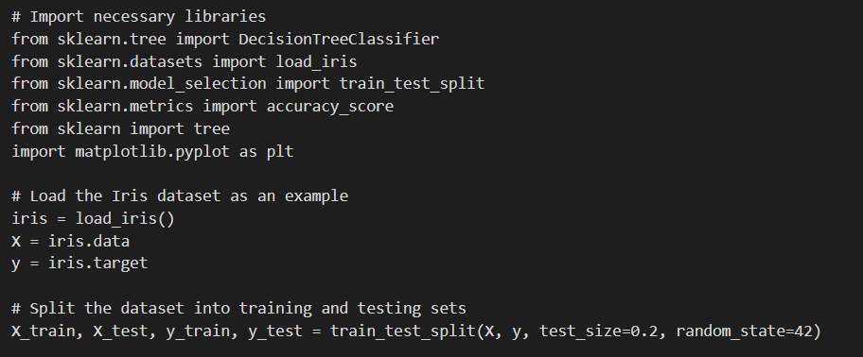
2.) How to Build CART Decision Trees Using R/Python
To build a CART (Classification and Regression Trees) decision tree using Python, you can use the scikit-learn library, which provides a convenient implementation for decision tree algorithms. Here's a simple example using scikit-learn:

Slide 45
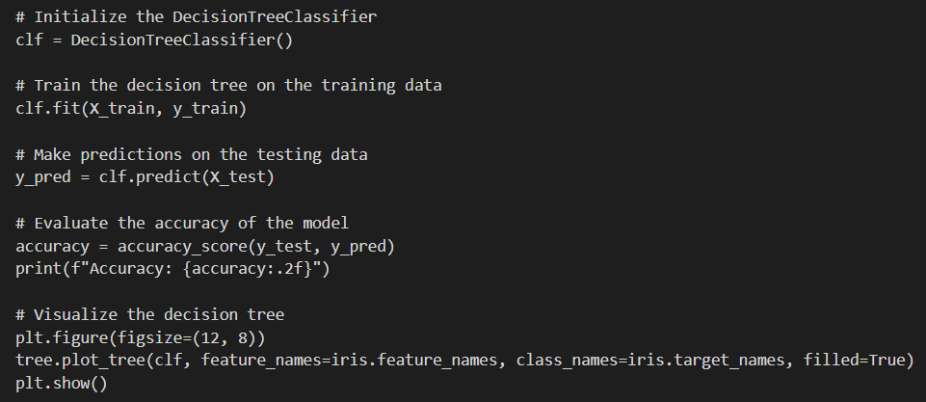

Slide 46
This example uses the Iris dataset, which is a popular dataset for classification tasks. The code does the following :
Load the Iris dataset.
Split the dataset into training and testing sets.
Initialize the DecisionTreeClassifier.
Train the decision tree on the training data.
Make predictions on the testing data.
Evaluate the accuracy of the model.
Visualize the decision tree.

Slide 47
4). How to Build C5.0 Decision Trees Using Python
C5.0 is a decision tree algorithm developed by Ross Quinlan and is a successor to the ID3 and C4.5 algorithms. While scikit-learn doesn't provide a built-in implementation for C5.0, you can use the "RuleFit" library, which implements a version of C5.0. RuleFit is an algorithm that combines decision trees with linear models and can be used to mimic the behavior of C5.0.
Here's an example of how to use RuleFit in Python:

Slide 48
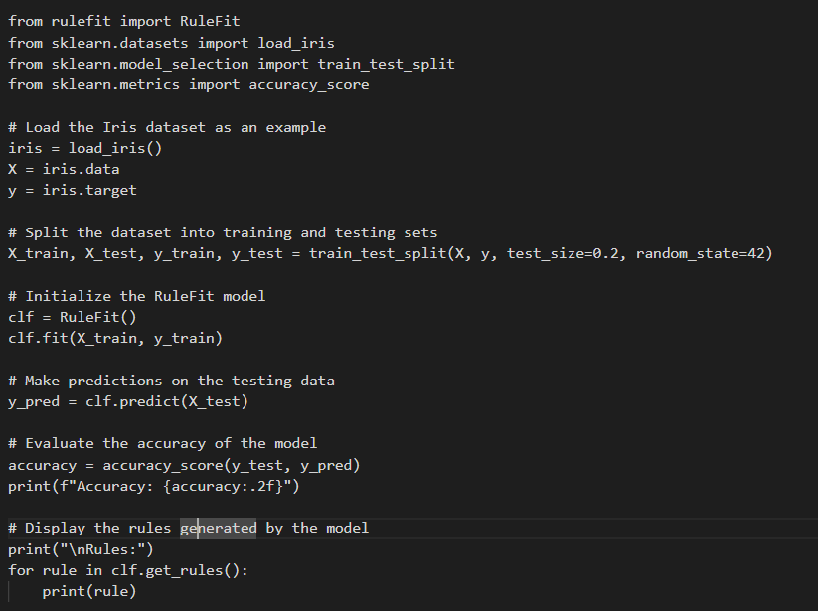
In this example, the RuleFit model is used as a substitute for C5.0. Note that RuleFit combines decision trees with linear models to create a set of interpretable rules. The rules generated by the model are displayed at the end of the script.

Slide 49
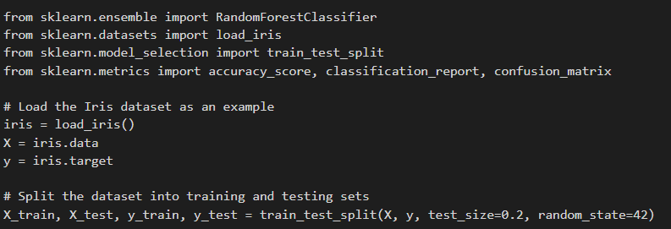
5.) How to Build Random Forests R/Python
Building Random Forests in Python is straightforward using the scikit-learn library, which provides a robust implementation of the Random Forest algorithm. Here's an example of how to build a Random Forest classifier using scikit-learn:

Slide 50
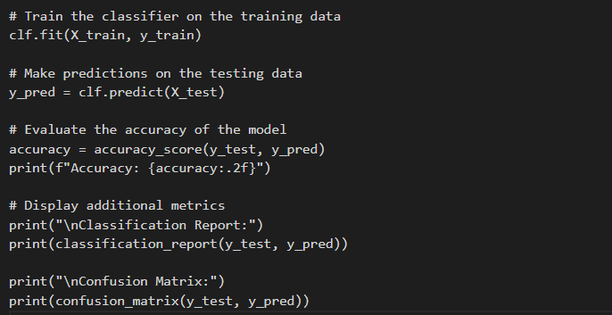
This example uses the Iris dataset, splits it into training and testing sets, initializes a Random Forest classifier with 100 trees, trains the model on the training data, and evaluates its performance on the testing data.

Slide 51
#5. Model Evaluation
1). How to Perform Model Evaluation Using R/Python
Model evaluation is a critical step in machine learning to assess how well your model is performing on new, unseen data. Here's a step-by-step guide using Python to perform model evaluation:

Slide 52
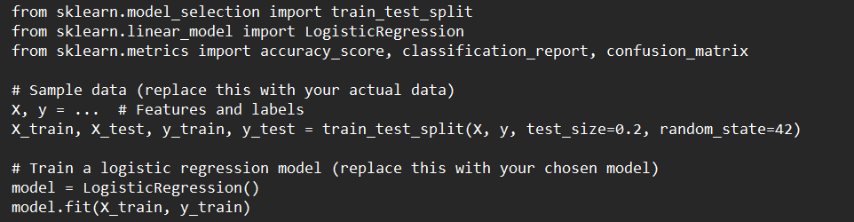
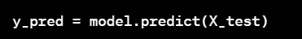
I). Train a Machine Learning Model:
First, train your machine learning model on a training dataset. For illustration purposes, we will use a simple example with a logistic regression model.
II). Make Predictions:
Use the trained model to make predictions on the test dataset.

Slide 53


III). Evaluate the Model:
Accuracy Score: Calculate the accuracy of your model.
Confusion Matrix: Understand the true positives, true negatives, false positives, and false negatives.

Slide 54


Classification Report: Get a summary report including precision, recall, and F1-score.
IV). Cross-Validation:
Use cross-validation to get a more robust evaluation. This is particularly important to ensure your model generalizes well to different subsets of the data.

Slide 55

V). Receiver Operating Characteristic (ROC) Curve and Area Under the Curve (AUC):
For binary classification problems, you might want to check the ROC curve and AUC.

Slide 56
VI). Adjust for Imbalanced Datasets:
If your dataset is imbalanced, consider using metrics such as precision, recall, and F1-score instead of accuracy.
VII). Hyperparameter Tuning:
If your model has hyperparameters, consider using techniques like grid search or random search for hyperparameter tuning.

Slide 57
2). Accounting for Unequal Error Costs Using Python
When dealing with imbalanced datasets, where the cost of errors for different classes is unequal, it's crucial to account for these costs during the evaluation and optimization of your machine learning model. In Python, you can achieve this using techniques such as cost-sensitive learning, custom scoring functions, or adjusting the decision threshold. Here's a brief guide:

Slide 58

Cost-sensitive Learning:
We can assign different weights to classes in our model to penalize misclassifications differently. This can be done using the class_weight parameter in many scikit-learn classifiers. For example:

Slide 59

Custom Scoring Function:
You can use a custom scoring function when using cross-validation or grid search to optimize your model. For example, you might define a scoring function that takes into account the imbalanced nature of your dataset:

Slide 60

Adjusting Decision Threshold:
If your model provides probability scores, you can adjust the decision threshold to trade off precision and recall. This is particularly useful in situations where one class is more critical, and you want to avoid false positives or false negatives.

Slide 61
#6. NAÏVE BAYES CLASSIFICATION
Demonstrate application of Naïve Bayes Using R/Python:
Let's demonstrate the application of Naive Bayes using the famous Iris dataset. We'll use the MultinomialNB classifier from scikit-learn, which is suitable for discrete features (like word counts).

Slide 62


Slide 63


Slide 64

#6. NEURAL NETWORKS
Demonstrate application of NEURAL NETWORKS using Python

Slide 65


Slide 66
In this example:
We load and preprocess the Fashion MNIST dataset.
We create a simple neural network with one hidden layer using the Sequential API of Keras.
The model is compiled with the Adam optimizer and sparse categorical crossentropy loss.
We train the model on the training set for 10 epochs.
Finally, we evaluate the model on the test set and plot the training history.

Slide 67
#8. CLUSTERING
Demonstrate application of k‐MEANS CLUSTERING Using R/Python
Let's demonstrate the application of k-Means clustering using Python with the help of the KMeans algorithm from scikit-learn. In this example, we'll generate random data points and cluster them using k-Means.

Slide 68



Slide 69
In this example:
We generate random data points using the make_blobs function from scikit-learn.
We visualize the generated data.
We apply the k-Means clustering algorithm with n_clusters=4.
We visualize the clusters and highlight the cluster centroids.

Slide 70
#9. REGRESSION MODELLING
1). Demonstrate Estimation Model Evaluation Using Python:
The term "estimation model" is quite general, so we will provide a demonstration of model evaluation using a regression model. Specifically, we will use the Linear Regression model as an example. The evaluation metrics commonly used for regression models include Mean Squared Error (MSE), R-squared, and Mean Absolute Error (MAE).

Slide 71



Slide 72
In this example:
We generate random data for demonstration purposes.
The data follows a linear relationship with some added noise.
We split the data into training and testing sets.
A Linear Regression model is trained on the training set.
Predictions are made on the test set.
We evaluate the model using Mean Squared Error (MSE), R-squared (R2), and Mean Absolute Error (MAE).
Finally, we visualize the actual data points and the regression line.

Slide 73

2). Demonstrate Stepwise Regression Using Python
Stepwise regression is a method for selecting a subset of predictor variables to include in a regression model. It typically involves adding or removing predictors based on statistical criteria. In Python, we can use the stats models library to perform stepwise regression. Here's a simple example:

Slide 74


Slide 75
In this example:
We generate a sample dataset with three predictor variables (X1, X2, X3) and a response variable (Y).
The stepwise_regression function iteratively adds the predictor with the lowest p-value to the model until no more predictors meet a certain criterion (e.g., a significance level).
The final model is fitted using the selected features, and the summary is displayed.

Slide 76
#10. DIMENSION REDUCTION
1). Demonstrate How you will Identify Multicollinearity Python:
Multicollinearity occurs when two or more independent variables in a regression model are highly correlated, making it difficult to determine the individual effect of each variable on the dependent variable. In Python, you can identify multicollinearity using various methods, such as correlation matrices, variance inflation factors (VIF), and eigenvalues.
Here's a demonstration using the VIF approach with the statsmodels library:

Slide 77


Slide 78
In this example:
We use a subset of features from the Boston Housing dataset.
The VIF values are calculated for each feature using the variance_inflation_factor function from statsmodels.
VIF values greater than a certain threshold (commonly 5 or 10) suggest multicollinearity.

Slide 79
In this example:
We use a subset of features from the Boston Housing dataset.
The VIF values are calculated for each feature using the variance_inflation_factor function from statsmodels.
VIF values greater than a certain threshold (commonly 5 or 10) suggest multicollinearity.

Slide 80
In this example:
We use a subset of features from the Boston Housing dataset.
The VIF values are calculated for each feature using the variance_inflation_factor function from statsmodels.
VIF values greater than a certain threshold (commonly 5 or 10) suggest multicollinearity.

Slide 81

2). Demonstrate HOW you’ll apply PRINCIPAL COMPONENTS ANALYSIS Using Python:
We'll use the famous Iris dataset for this example.

Slide 82
In this example:
We load the Iris dataset and standardize the features, which is an important preprocessing step for PCA.
PCA is applied with two components for visualization purposes.
The transformed data is visualized in the new space created by the first two principal components.
The explained variance ratio is printed to show the proportion of variance explained by each principal component.

Slide 83
#11: LOGISTIC REGRESSION MODELLING
1.) How to Perform Logistic Regression Using Python
Performing logistic regression in Python can be done using the scikit-learn library, which provides a simple and effective implementation of logistic regression. Here's a basic example using scikit-learn:

Slide 84

In this example, logistic regression is performed on a subset of the Iris dataset, considering only two classes (binary classification). The script splits the dataset into training and testing sets, initializes a logistic regression model, trains the model on the training data, and evaluates its performance on the testing data.

Slide 85
2.) How to Perform Poisson Regression Using R/Python
Performing Poisson regression in Python can be done using the statsmodels library, which provides a comprehensive set of statistical models. Poisson regression is suitable for modeling count data, where the response variable represents the number of events in fixed intervals of time or space. Here's an example:

Slide 86


Slide 87
In this example:
We generate synthetic data with two independent variables (‘X[:, 0]’ and ‘X[:, 1]’) and a dependent variable (‘y’) following a Poisson distribution.
The dataset is split into training and testing sets.
A constant term is added to the features for the intercept.
The Poisson regression model is fitted using the ‘GLM’ (Generalized Linear Model) class from ‘statsmodels.’
Predictions are made on the testing data, and the model is evaluated using mean squared error.
The summary of the Poisson regression model is displayed.

Slide 88
#12. ASSOCIATION RULES
1). How to Mine Association Rules Using Python:
Mining association rules is a data mining technique that discovers interesting relationships, patterns, or associations among a set of items in large datasets. In Python, you can use the mlxtend library, which provides a convenient implementation of the Apriori algorithm for mining association rules. Here's a basic example:

Slide 89


Slide 90
In this example:
We create a sample dataset representing transactions.
The dataset is one-hot encoded, converting it into a binary format suitable for association rule mining.
The Apriori algorithm is used to find frequent itemsets based on a specified minimum support.
Association rules are generated from the frequent itemsets with a minimum confidence threshold.

Slide 91
2). How to Apply the Confidence Difference Criterion Using Python:
The confidence difference criterion is not a standard term in association rule mining; however, you might be referring to evaluating or filtering association rules based on a difference in confidence between two sets of rules. In the context of association rules, confidence is a measure of the likelihood that the rule holds true.
Here's an example using Python with the mlxtend library, where we filter rules based on a confidence difference threshold:

Slide 92


Slide 93
In this example, we calculate the absolute difference between the confidence of the whole rule and the confidence of the antecedent. You can adjust the confidence_difference_threshold to filter rules based on your specific criteria.

Slide 94
3). How to Apply the Confidence Quotient Criterion Using Python:
The "confidence quotient criterion" is not a standard term in association rule mining. However, if you are referring to a criterion based on the quotient (ratio) of confidences between two sets of rules, you can apply it similarly to the confidence difference criterion, by evaluating or filtering association rules based on a ratio of confidences.
Here's an example using Python with the mlxtend library, where we filter rules based on a confidence quotient threshold:

Slide 95

In this example, we calculate the ratio of the confidence of the whole rule to the confidence of the antecedent. Adjust the confidence_quotient_threshold to filter rules based on your specific criteria.

Slide 96
THE END!

